Slide 1





Automatic music generation
Team: HARSAN.M.S
Email ID: nhharsan0206@gmail.com
GUIDE:(P.RAJA,MASTER TRAINER)
Disclaimer: The content is curated for educational purposes only.
Notes:
Slides: Prepare a short slide deck (10-12 slides) summarizing the project objectives, methodology, and key results.

Slide 2
OUTLINE
Abstract
Problem Statement
Proposed System/Solution
Algorithm & Deployment
GitHub Link
Project Demo(photos / videos)
Conclusion
Future Scope
References
Notes:
Nnmm

Slide 3
Abstract
Abstract: This project explores the use of artificial intelligence (AI) to autonomously generate music. The goal is to create an AI system that can compose music across different genres by leveraging machine learning models, including Recurrent Neural Networks (RNNs) and Generative Adversarial Networks (GANs). The system allows users to customize input parameters such as genre, mood, and instrumentation.

Slide 4
Problem Statement
Problem Statement: With the increasing accessibility of artificial intelligence (AI), music generation has become an exciting area of exploration. Traditional music composition requires considerable time, skill, and creativity, but AI-driven approaches promise to automate the process. However, generating music that maintains both technical quality and emotional depth remains a challenge for AI systems.

Slide 5
Proposed Solution
A proposed solution for automatic music generation involves developing an AI-driven system that combines machine learning, particularly deep learning models, with diverse musical datasets to generate original, high-quality compositions. The system should be modular and flexible, allowing users to specify elements like genre, mood, and instrumentation, while ensuring that the generated music adheres to key musical principles such as tonality, rhythm, and form. It should incorporate creativity and randomness to produce unique outputs, support real-time interaction, and offer tools for human collaboration, allowing users to refine and guide the AI’s creations. Additionally, the system must ensure diversity, avoid biases, and respect ethical standards related to authorship and ownership of the generated music.

Slide 6
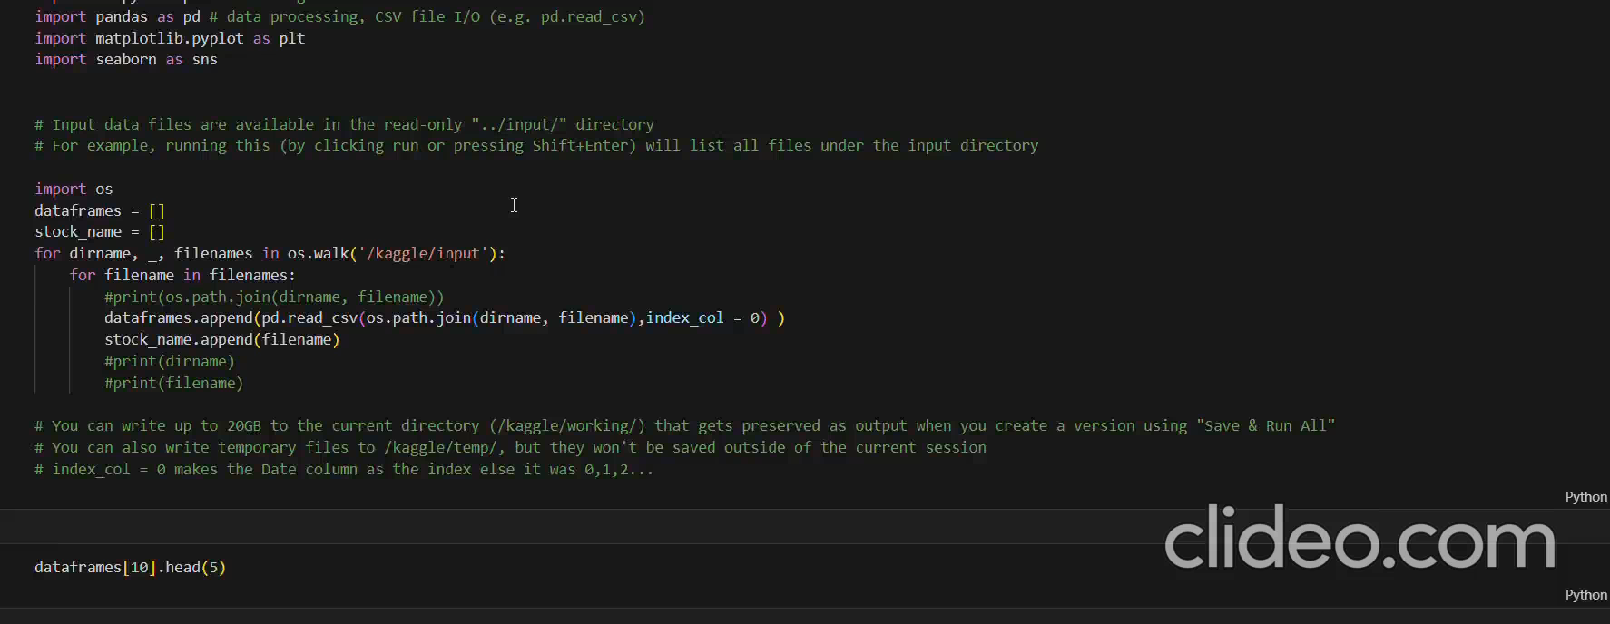
Video of Project Demo

Slide 7
Conclusion
In conclusion, automatic music generation has the potential to revolutionize creative processes by providing powerful tools for musicians, composers, and content creators. By leveraging advanced AI techniques and diverse musical data, such systems can generate innovative and unique compositions across various genres and styles. However, it is crucial that these systems prioritize musical coherence, user collaboration, and ethical considerations, ensuring that they complement human creativity rather than replace it. With ongoing advancements in machine learning and user feedback integration, automatic music generation can become a valuable resource that inspires creativity, fosters innovation, and enhances the overall music-making experience.

Slide 8
Future Scope
Personalised music generation
Real time, interactive and composition
Enhanced emotions and expressions
AI driven music, production, and mixing

Slide 9
Thank you!
Notes:
thank you very much for joining this PPT, keep learning.
9

